Slide 1


Customer Segmentation Analysis
Clustering Customers for Targeted Marketing
By Dustin Casey

Slide 2
Overview
What business problem are we trying to find a solution for?
What data do we have to work with?
How can we implement a K-Nearest Neighbors learning algorithm?

Slide 3
Background/Business Problem
An owner of a small business wants to know how to best spend marketing dollars
Which customers are the best to target?
Which customers rate highest?
How do they relate to one another?
Do they have similar characteristics?
By answering these questions, we hope to group similar customers and identify which groups are our desired customers to target

Slide 4
What data do we have to answer this question?
Dataset of 200 former customers
Customer metrics/characteristics
Gender
Age
Annual Income
A customer Spending Score assigned based on how highly we rate them as a customer

Slide 5
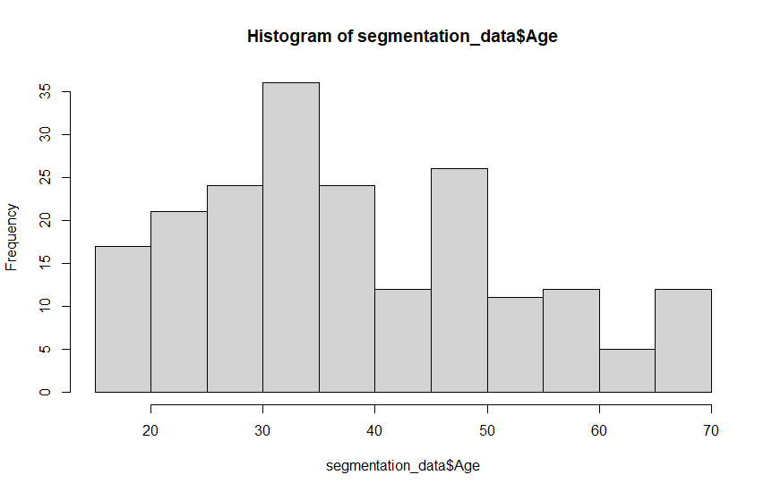
Histogram of Age
Age

Slide 6
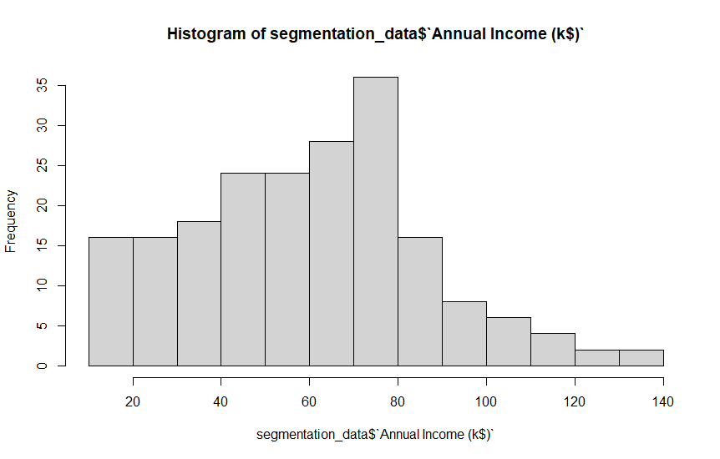
Histogram of Annual Income (k$)
Annual Income (k$)

Slide 7
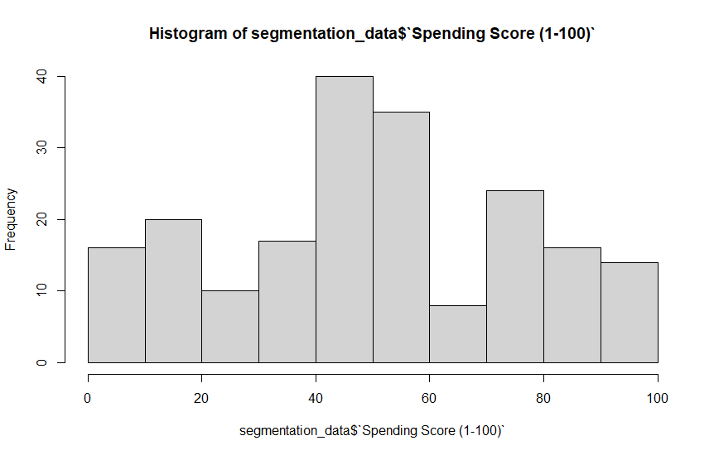
Histogram of Spending Score
Spending Score

Slide 8
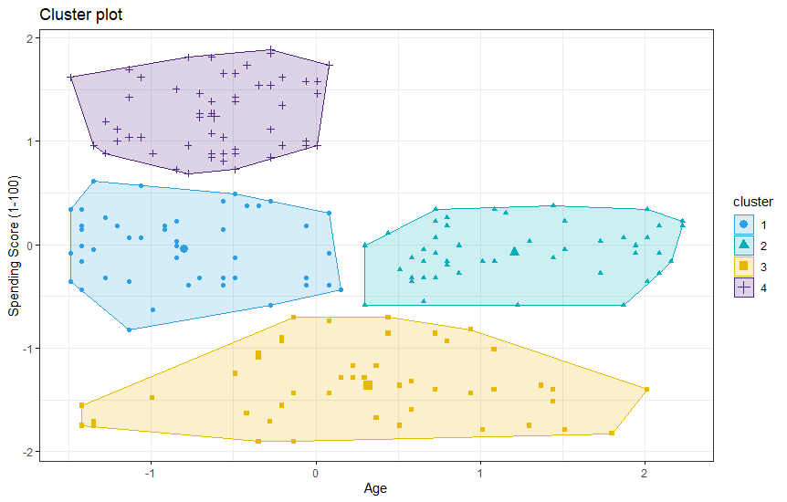
K-Means/K-Nearest Neighbor Clustering
First wanting to cluster customers by Age
Determined that 4 clusters would be needed based off of the data
Clustered customers and plotted the clusters. I determined that:
Group 4 are the ideal target group
Groups 1 & 2 are decent options
Group 3 should be the last group targeted

Slide 9
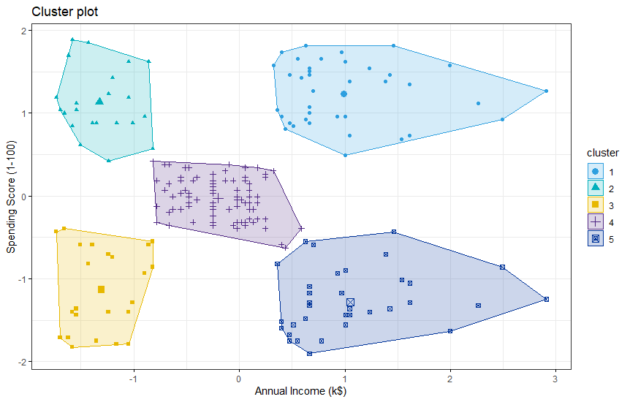
Clustering by Annual Income (k$)
Next clustering customers by Annual Income
Determined that 5 clusters would be needed based off of the data
Clustered customers and plotted the clusters. I determined that:
Groups 1 & 2 are the ideal target group
Groups4 is a decent option
Groups 3 & 5 should be the last groups targeted

Slide 10
Ethical Assessment
For this analysis, the biggest ethical issues facing the project is customer privacy.
In the current analysis, we are asking for some sensitive data
Many people don’t want to share this information and will not likely want the store to have even more data on them if we were to try to collect additional metrics
One thing to keep in mind though is in today’s world, our data is being collected and passed around so much already and a store collecting your data isn’t unheard of

Slide 11
Conclusion
Clustering and Customer Segmentation can be a huge benefit for cost savings and increased revenue and sales
It will be key to test how well we clustered after starting the marketing campaign and refresh the model with new data every so often
It’s a win-win that will only yield more accurate results as time goes on and we hone in on our ideal customer clusters

